Slide 1
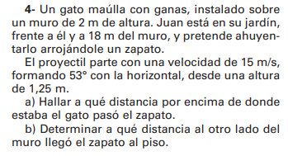













$$y\left(t\right)=y_{o}+v_{0y}.t+\frac{1}{2}.g.t^{2}$$
$$x\left(t\right)=x_{o}+v_{x}.t$$
$$v_{0y}=v_{0}.sen 53°$$
$$v_{x}=v_{0}.\cos{53° }$$
$$v_{x}=15\frac{m}{s}.\cos{53° }$$
$$v_{0y}=15\frac{m}{s}.sen 53°$$
$$v_{0y}=12\frac{m}{s}$$
$$v_{x}=9\frac{m}{s}$$
$$y(m)$$
$$18m=0m+9\frac{m}{s}.t$$
$$v_{o}$$
$$18m=9\frac{m}{s}.t$$
2
$$2s=t$$
53°
1,25
18

Slide 2





$$y\left(2s\right)=1,25m+12\frac{m}{s}.2s+\frac{1}{2}.(−10\frac{m}{s^{2}}).{\left(2s\right)}^{2}$$
$$x(m)$$
$$y\left(2s\right)=1,25m+24m+\frac{1}{2}.(−10\frac{m}{s^{2}}).4s^{2}$$
$$y\left(2s\right)=1,25m+24m−20m$$
$$y\left(2s\right)=5,25m$$

