Slide 1
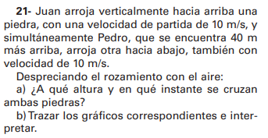




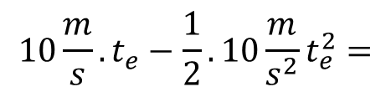
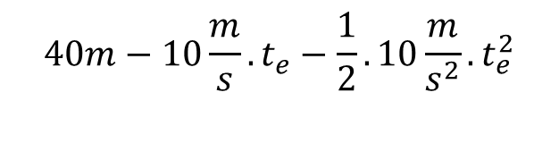



+
$$40m$$
$${\vec{v}}_{0 PEDRO}$$
$$y_{JUAN}\left(t\right)=0m+10\frac{m}{s}.t−\frac{1}{2}.10\frac{m}{s^{2}}.t^{2}$$
$$y_{PEDRO}\left(t\right)=40m−10\frac{m}{s}.t−\frac{1}{2}.10\frac{m}{s^{2}}.t^{2}$$
Cuando se cruzan las piedras, las alturas coinciden
$${\vec{v}}_{0 JUAN}$$
$$y_{JUAN}\left(t\right)=y_{PEDRO}\left(t\right)$$
$$0m$$
$$10\frac{m}{s}.t_{e}−\frac{1}{2}.10\frac{m}{s^{2}}t_{e}^{2}=$$
$$40m−10\frac{m}{s}.t_{e}−\frac{1}{2}.10\frac{m}{s^{2}}.t_{e}^{2}$$

Slide 2
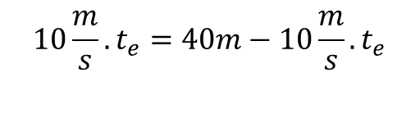



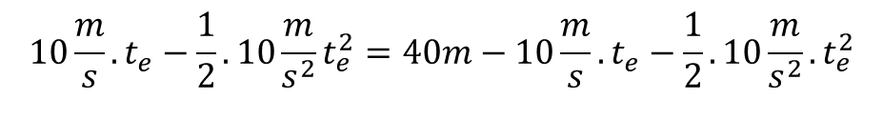





$$10\frac{m}{s}.t_{e}−\frac{1}{2}.10\frac{m}{s^{2}}t_{e}^{2}=40m−10\frac{m}{s}.t_{e}−\frac{1}{2}.10\frac{m}{s^{2}}.t_{e}^{2}$$
$$y_{JUAN}\left(t\right)=0m+10\frac{m}{s}.t−\frac{1}{2}.10\frac{m}{s^{2}}.t^{2}$$
$$10\frac{m}{s}.t_{e}=40m−10\frac{m}{s}.t_{e}$$
$$y_{JUAN}\left(2s\right)=10\frac{m}{s}.2s−\frac{1}{2}.10\frac{m}{s^{2}}. {\left(2s\right)}^{2}$$
$$y_{JUAN}\left(2s\right)=20m−\frac{1}{2}.10\frac{m}{s^{2}}. 4s^{2}$$
$$10\frac{m}{s}.t_{e}+10\frac{m}{s}.t_{e}=40m$$
$$y_{JUAN}\left(2s\right)=20m−20m$$
$$20\frac{m}{s}.t_{e}=40m$$
$$y_{JUAN}\left(2s\right)=0m$$
$$t_{e}=2s$$

