Slide 1
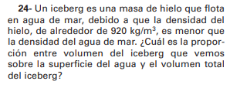
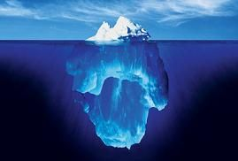
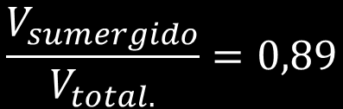




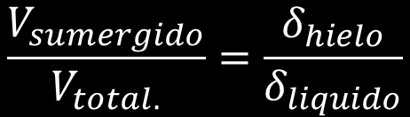



$$\vec{E}$$
$$E−P=0$$
$$δ_{liquido}.V_{sumergido}.g−m.g=0$$
$$δ_{liquido}.V_{sumergido}.g−δ_{hielo}.V_{total.} g=0$$
$$\vec{P}$$
$$δ_{liquido}.V_{sumergido}.g=δ_{hielo}.V_{total.} g$$
$$\frac{V_{sumergido}}{V_{total.}}=0,89$$
$$δ_{liquido}.V_{sumergido}=δ_{hielo}.V_{total}$$
$$\frac{V_{sumergido}}{V_{total.}}=\frac{920\frac{kg}{m^{3}}}{1025\frac{kg}{m^{3}}}$$
$$\frac{V_{sumergido}}{V_{total.}}=\frac{δ_{hielo}}{δ_{liquido}}$$
$$\frac{V_{visible}}{V_{total.}}=0,11$$

